Slide 1
Broad topics
The basics of genetic information flow and the genetic code
The chemical basis of nucleic acid and protein structure and function
PCR
Cloning
Genome structure
DNA replication

Slide 2
The flow of genetic information: be prepared to diagram it

Slide 3
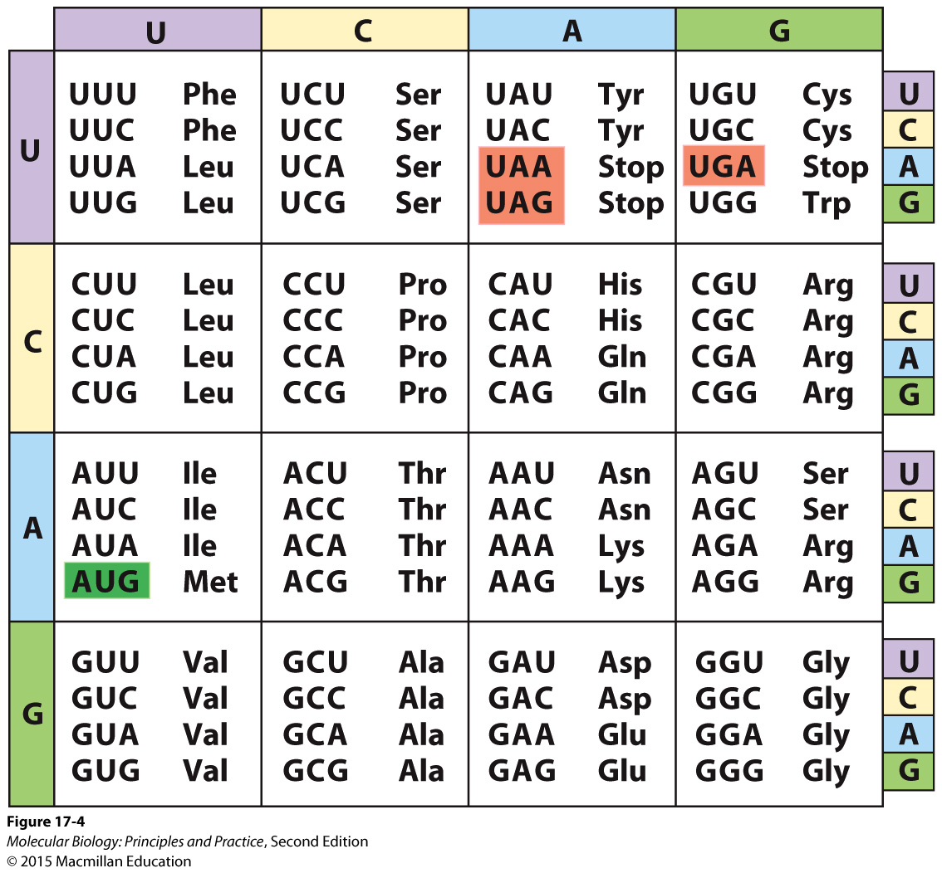
The genetic code: be prepared to translate any sequence you are given

Slide 4
The effect that mutations may have on gene function and why
Base/nt changes
Insertions or deletions

Slide 5
Enzymes and enzymatic activities that you should know (in no particular order, and not an exclusive list)
Reverse transcriptase
DNA polymerases I and III
DNA helicase
Restriction endonuclease
Endonuclease
Exonuclease
Topoisomerase
DNA ligase

Slide 6
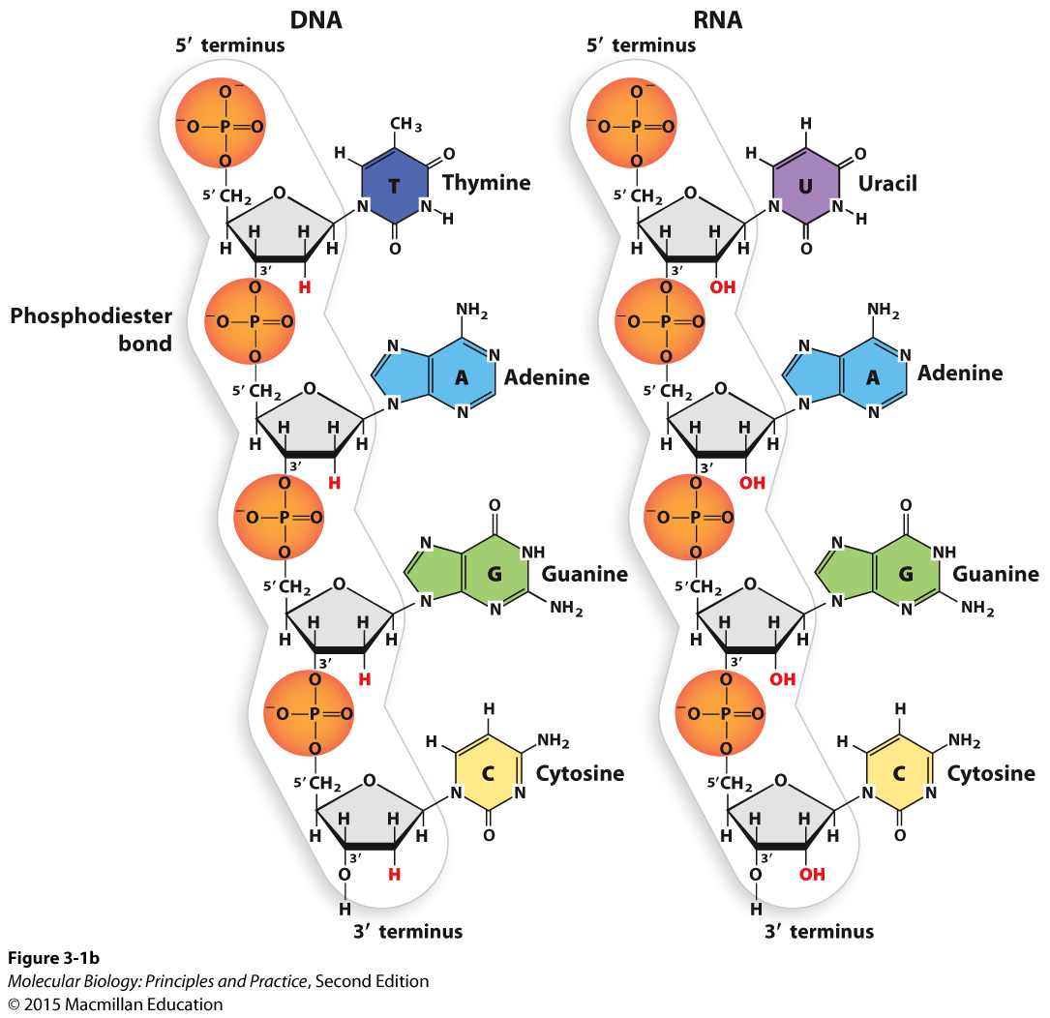
The chemical structures of nucleic acids
Be prepared to draw the chemical structure of a DNA or RNA backbone (don’t need to know base structures)
Identify 5’ and 3’ ends, 5’, 2’, and 3’ carbons, 2’ and 3’ OHs
Identify phosphodiester linkage
Identify ribose or deoxyribose, phosphate group, hydroxyl group(s)
Know differences between DNA and RNA

Slide 7
Bonds, forces, and effects that mediate interactions within and between molecules
Covalent bonds
Hydrogen bonds (H-bonds)
Ionic bonds
van der Waals forces
Hydrophobic effect
Stacking (comprised primarily of van der Waals and hydrophobic forces)

Slide 8
Nucleic acid structure cont’d
Primary and secondary structure, and the types of bonds that underlie them.
The bonds/forces/effects that cause double-stranded nucleic acids to form double helices.
The effects of the 2’ OH on RNA structure and function:
RNA is less stable than DNA due to the ability of the 2’ OH to carry out a nucleophilic attack on the phosphate (especially in alkaline conditions)
RNA can form a wider range of 3-dimensional structures because the 2’ OH can hydrogen bond with other atoms (intramolecular or intermolecular)
The 2’ OH changes the shape of the sugar
The 2’ OH can also mediate interactions with proteins

Slide 9
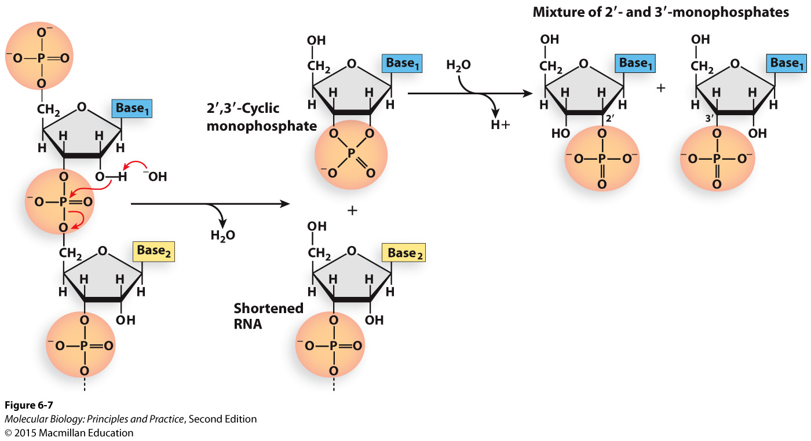
Spontaneous hydrolysis of RNA in basic conditions
The 2’ OH is deprotonated
The 2’ O carries out a nucleophilic attack on the phosphorus in the phosphate group
The phosphodiester linkage is broken, leaving a 5’ OH on one fragment and a phosphate linked to both the 2’ and 3’ carbons of the other fragment.
The unstable cyclic structure resolves to give a 2’ or 3’ phosphate.

Slide 10

Nucleophilic attacks and hydrogen bonding make sense when you consider which atoms will have partial negative and partial positive charges as a result of unequal sharing of electrons
Elements forming bond | Distribution of charge
Oxygen and hydrogen
Carbon and hydrogen
Nitrogen and hydrogen
Oxygen and carbon
Oxygen and phosphorus

Slide 11
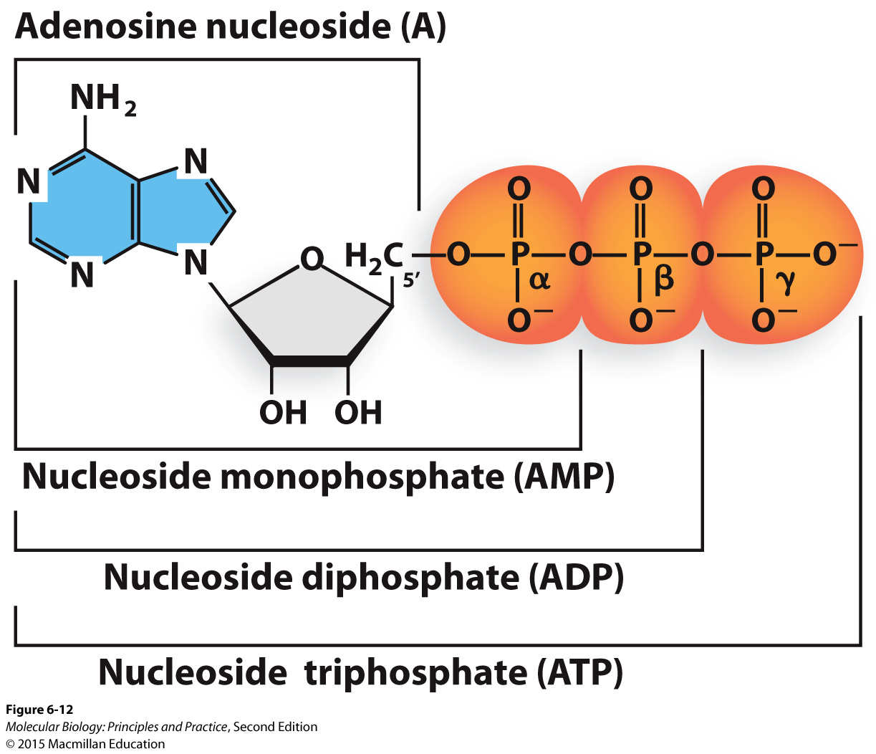
Nucleotides and nucleotide structure
Be prepared to tell me the composition of a given nucleotide (example: dGTP is a nucleotide composed of a guanine base, deoxyribose, and a 5’ triphosphate).
Be prepared to give the abbreviation for a given nucleotide.
What is the difference between a nucleotide and a base?

Slide 12
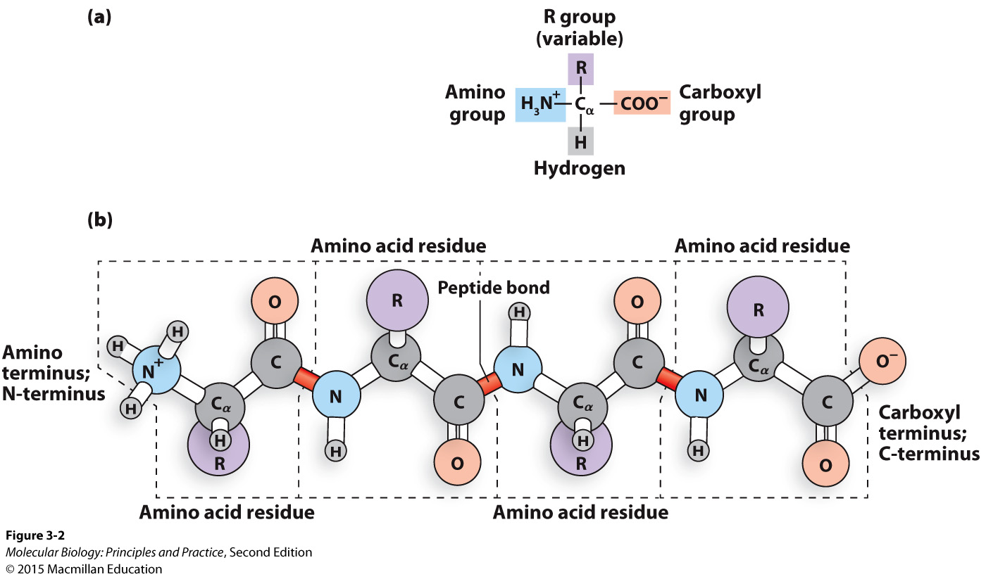
Protein/peptide/polypeptide structure

Slide 13
Protein/peptide/polypeptide structure
Be prepared to draw the chemical structure of a peptide backbone (with amino acid side chains indicated by “R”)
N and C termini
Peptide bonds
Residues (amino acids)
Know the bonds/forces/effects that mediate interactions between protein backbone atoms and atoms in the same protein/other proteins/other molecules
Know the bonds/forces/effects that mediate interactions between protein side chain atoms and atoms in the same protein/other proteins/other molecules
Given the chemical structure, indicate if an amino acid side chain is polar uncharged, non-polar, aromatic, or polar charged, and if it’s likely to interact with other molecules through covalent bonds, hydrogen bonds, ionic bonds, hydrophobic effects, and/or stacking interactions.

Slide 14
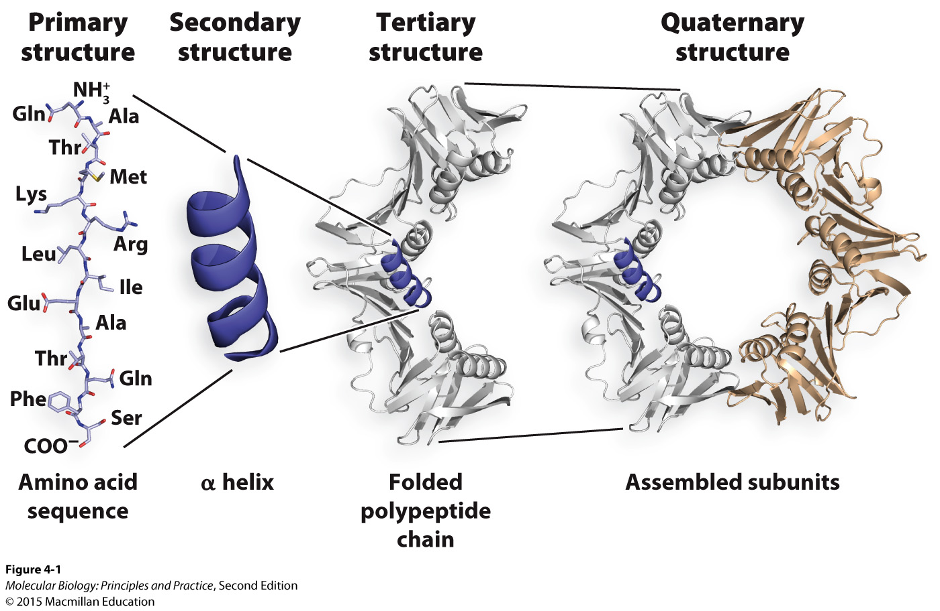
Protein/peptide/polypeptide structure cont’d
Define the four levels of protein structure, and describe the bonds/forces/effects responsible for each one.

Slide 15
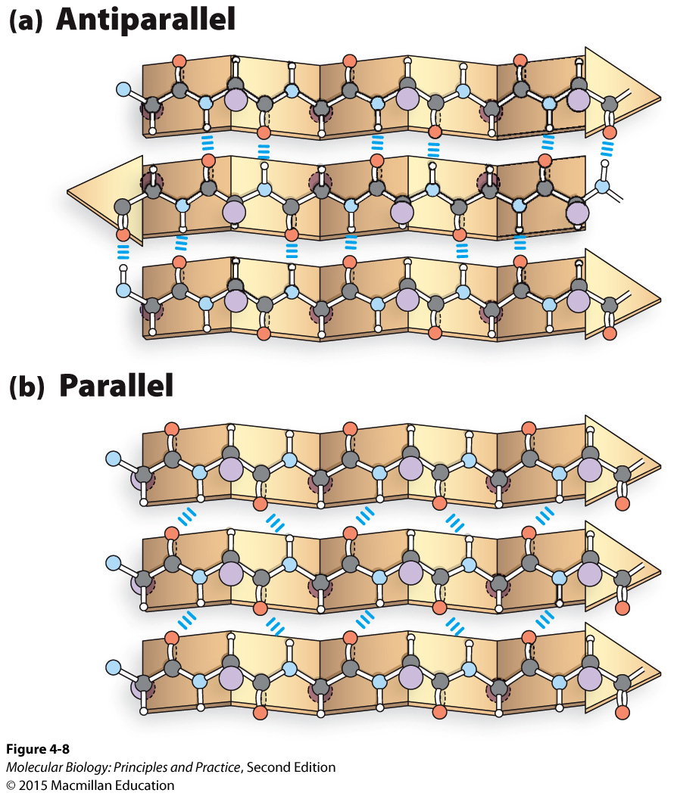
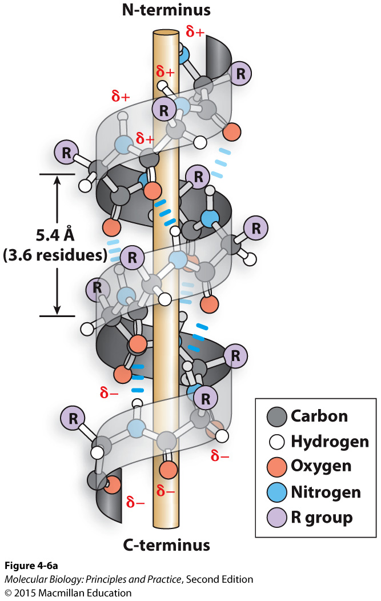
Protein/peptide/polypeptide structure cont’d
Alpha helices and beta sheets: describe the bonds that hold these together, and the respective roles of side-chain and backbone atoms.

Slide 16
Interactions between proteins and nucleic acids
Sequence-specific interactions involve direct molecular contact with the bases in the nucleic acid
Hydrogen bonds between bases and the protein
Non-sequence-specific interactions involve contact with atoms in the backbone of the nucleic acid, and non-specific interaction with bases such as stacking.

Slide 17
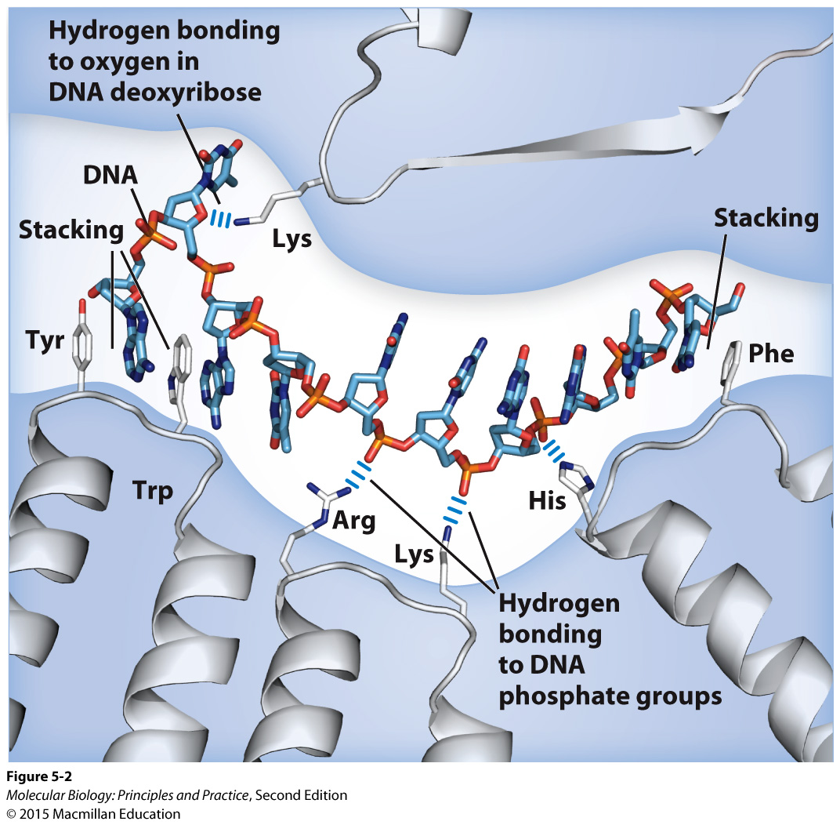
Examples of non-sequence-specific interactions between a single-stranded nucleic acid and a protein
Note that ss and ds nucleic acids will not bind to the same binding pocket (DNA binding proteins are usually structure-specific)

Slide 18
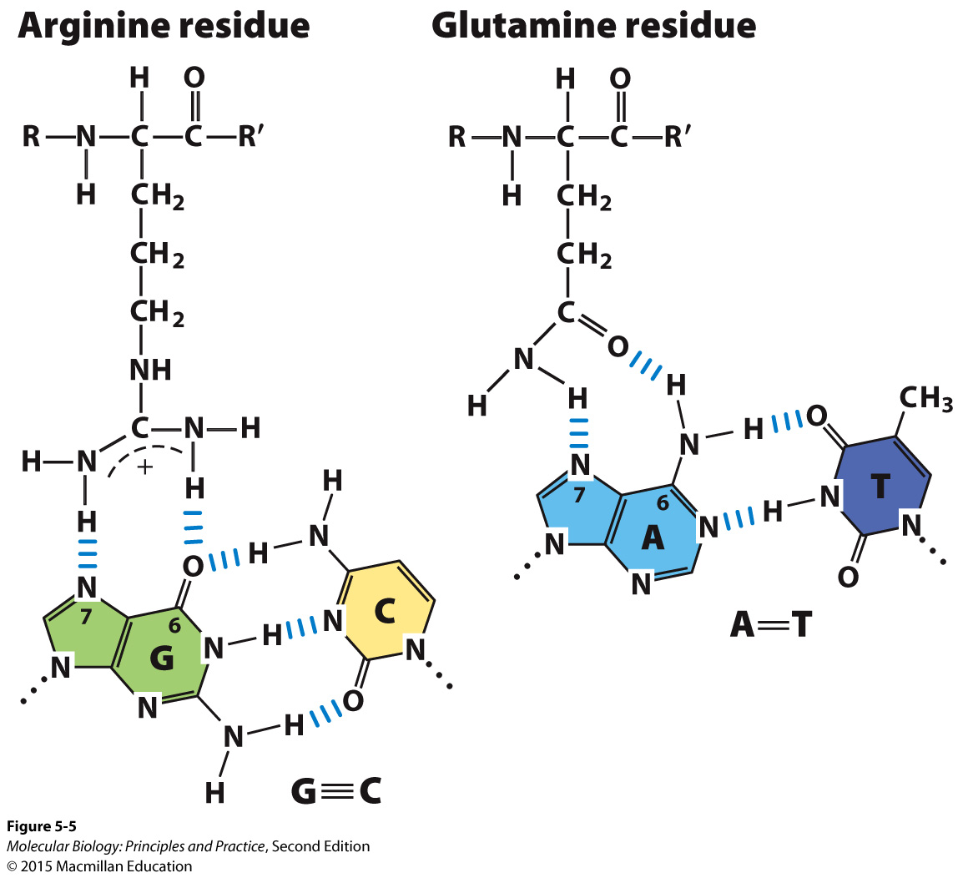
Examples of sequence-specific interactions between bases and amino acids
The bases are most often accessed at the major groove

Slide 19
PCR
What does it do, how does it do it, and why it is useful?
Know what components you need, and what the role of each one is.
Be prepared to design primers for any given template DNA sequence.
Be prepared to identify the sequence that will be amplified by a given set of primers.
Be prepared to design primers that will add additional sequences not present in the template.

Slide 20
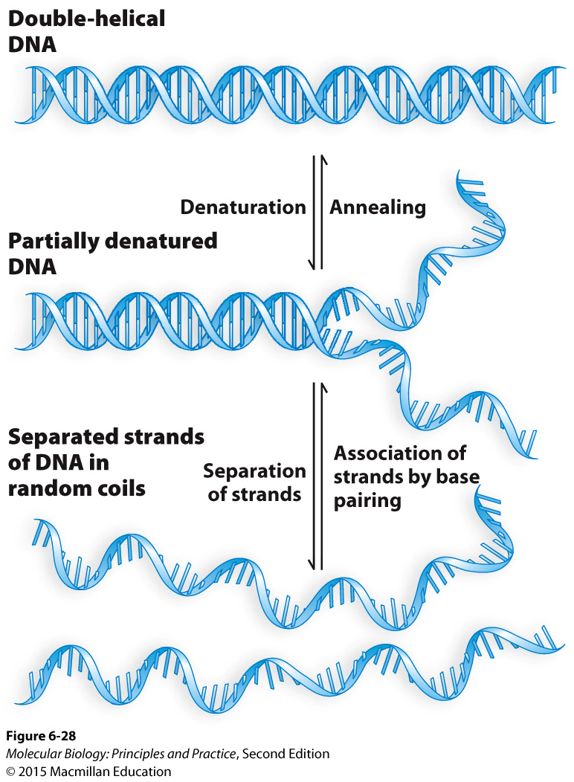
PCR
Understand annealing, denaturation (aka “melting”), Tm, and the significance of these for PCR.

Slide 21
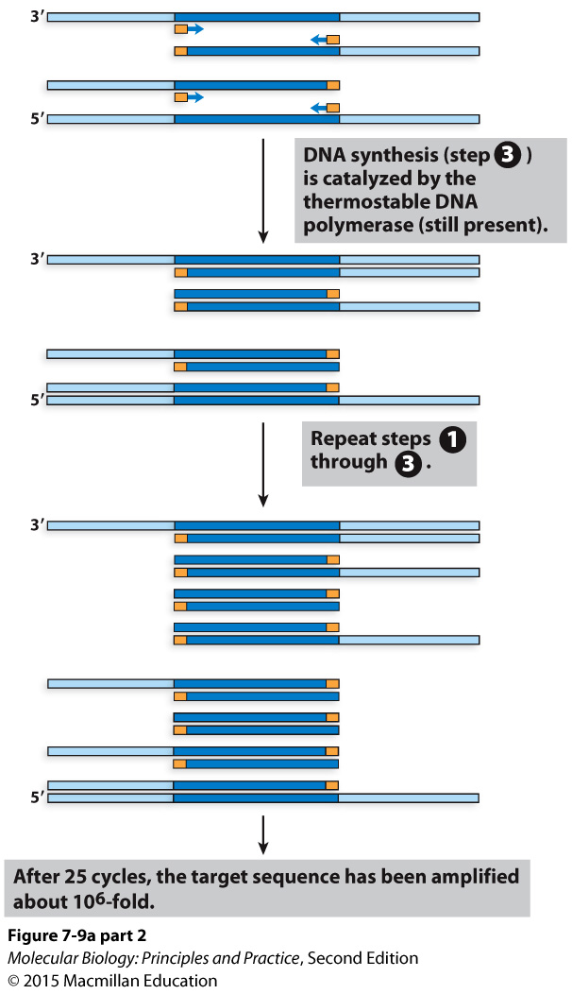
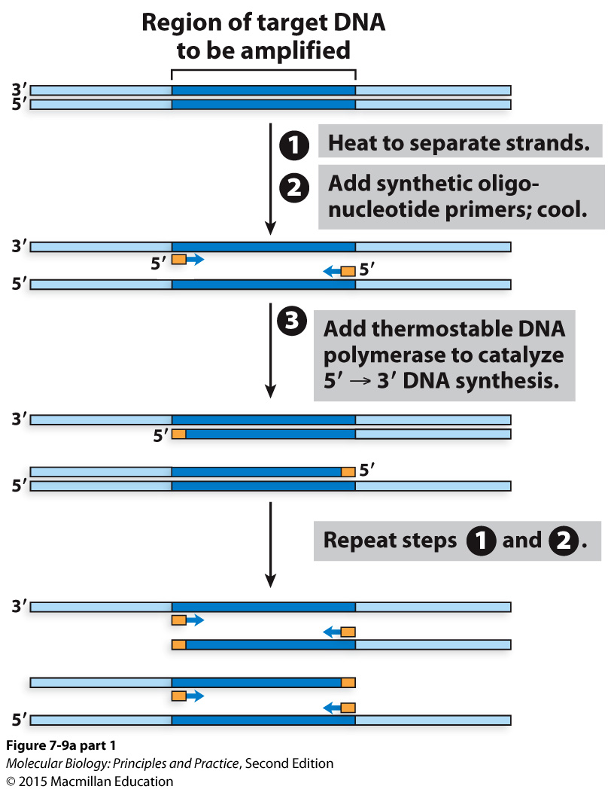
PCR diagramed

Slide 22
Cloning
What is it and why is it useful?

Slide 23
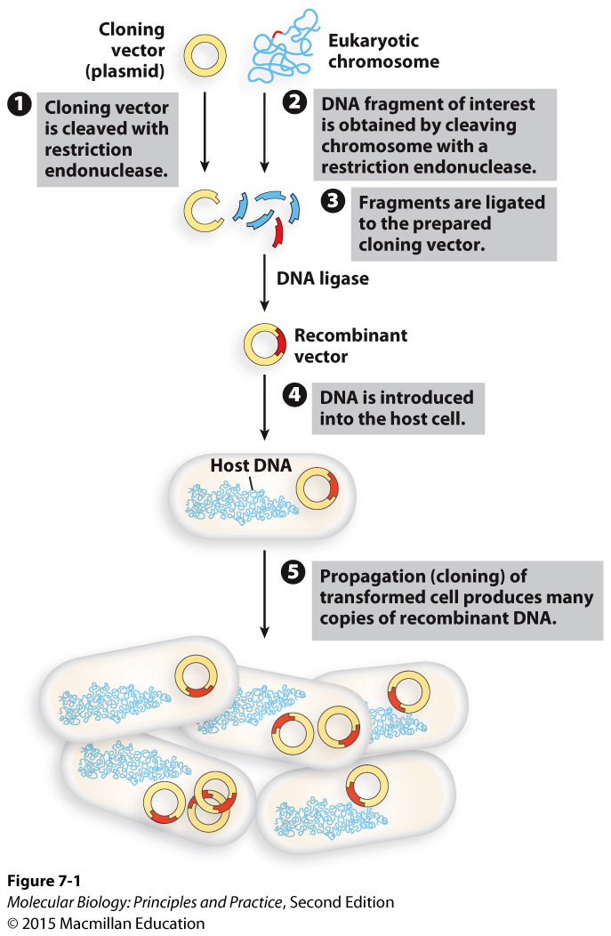
An overview of cloning with restriction enzymes (aka restriction endonucleases)
Or PCR with primer tails to add restriction sites – be prepared to design these
Putting DNA into a bacterium is transformation
For cloning, this is usually E. coli
Select on media containing drug to which the plasmid confers resistance
Isolate the plasmid and sequence it to confirm it’s correct, then:
Move it into an organism of interest (think of an example!)
Or, use E. coli as a “cellular factory” to express a protein for you.

Slide 24
Features needed for an E. coli cloning vector
Notes:
Minimal E. coli vector features:
Multiple cloning site (cluster of restriction enzyme recognition sites)
E coli origin of replication
Selectable marker (drug resistance)

Slide 25
Basic workflow for gene cloning
Notes:
PCR with restriction sites on primers
Digest PCR product and plasmid
Ligate
Transform into E. coli
Select on antibiotic
Isolate plasmid from E. coli, sequence

Slide 26
Basic workflow for gene cloning
Notes:
PCR with restriction sites on primers
Digest PCR product and plasmid
Ligate
Transform into E. coli
Select on antibiotic
Isolate plasmid from E. coli, sequence

Slide 27
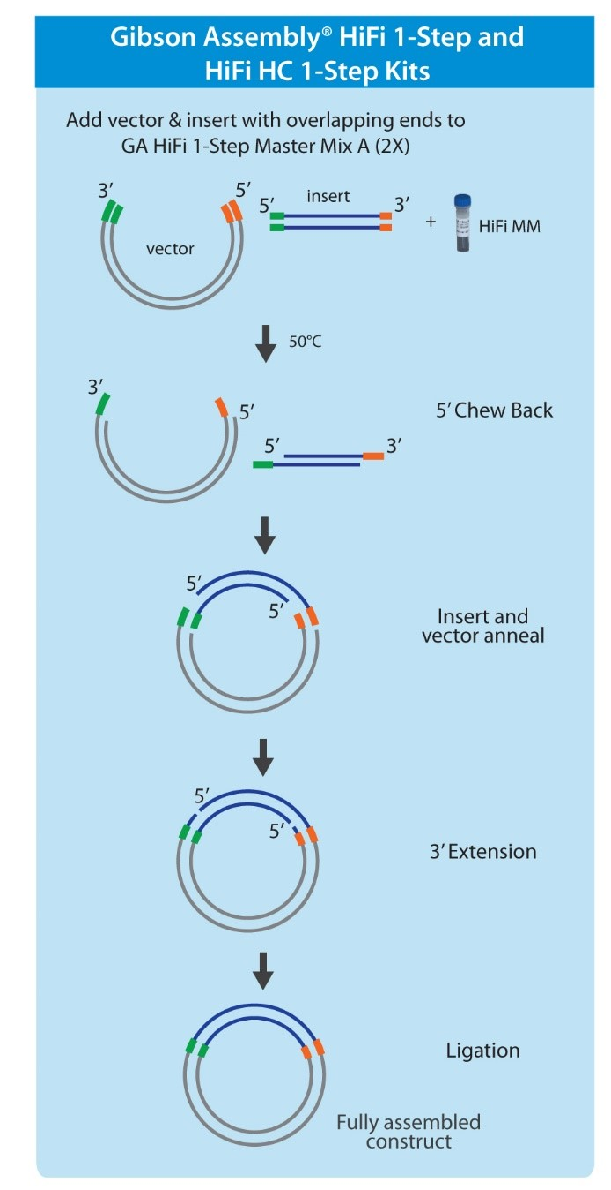
Cloning with Gibson Assembly (and closely related methods with different names)
Junctions can be anywhere; no need for restriction sites
Can assemble >2 pieces simultaneously
“Scarless” assembly
Know the three enzymatic activities involved
Need sequence overlap between insert and vector (or between multiple inserts)
Can prepare linear vector by restriction digest of PCR.

Slide 28
Another view showing the three enzymatic activities involved.
New England Biolabs HiFI cloning manual

Slide 33
The spectrum of cellular gene and genome structures
 | Prokaryotes | Eukaryotes
Chromosome shape | Usually circular | Linear
Plasmids | More frequent | Less frequent
Ploidy | Haploid | Variable
Protein coding content | ~80% | Variable (usually much less)
Introns | Rare | Common

Slide 34
DNA compaction and organization are the product of DNA compaction proteins and supercoiling
Notes:
Supercoiling
DNA binding proteins

Slide 35
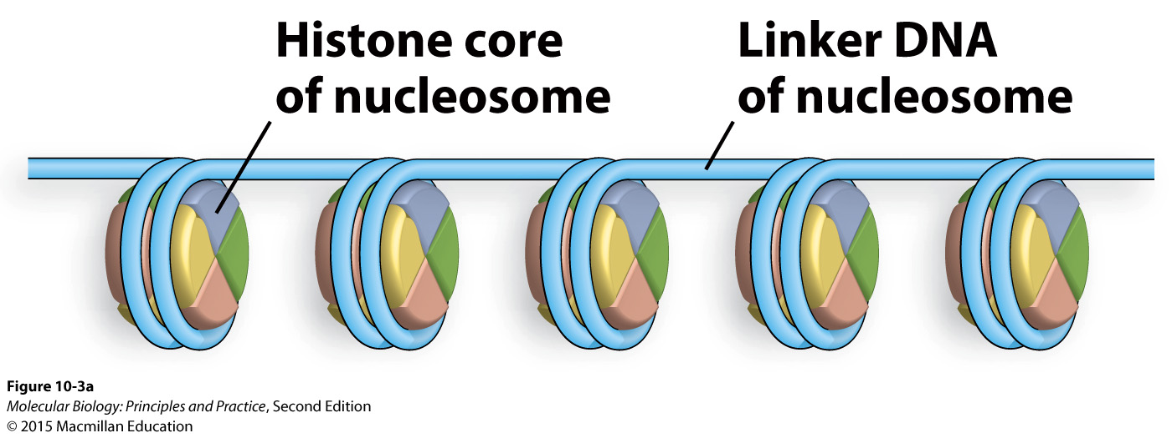
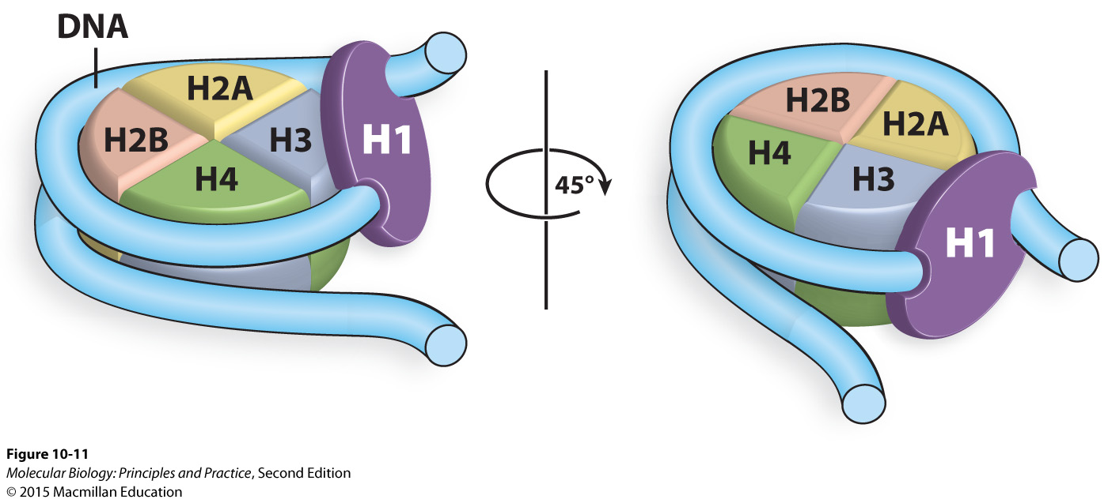
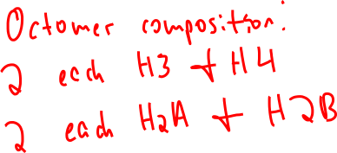
Histones constitute the first level of DNA compaction proteins
H1 is optional and leads to more tightly packed (transcriptionally inactive) chromatin

Slide 36
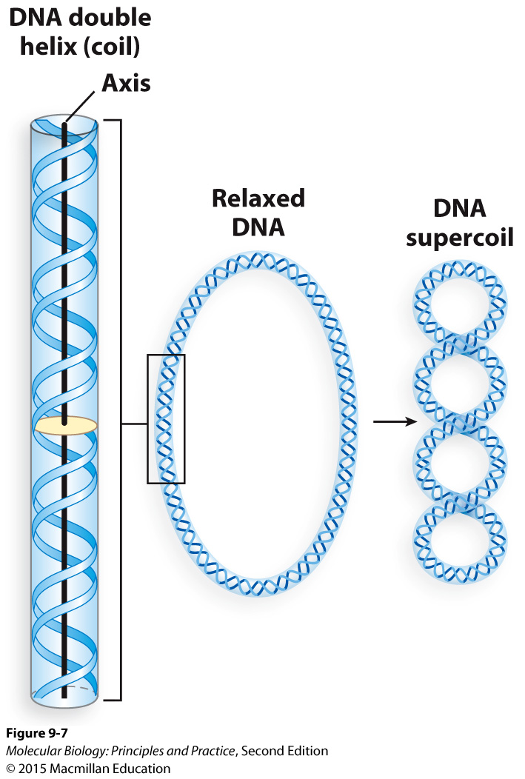
Supercoiling
Over-winding of the double helix is positive supercoiling, under-winding of the double helix is negative supercoiling.
Supercoiling can be considered as a local property or at the level of an entire chromosome or chromosomal domain.
If the ends of the DNA are fixed in place, local positive supercoiling must be balanced out by local negative supercoiling somewhere else in the molecule.
Only topoisomerase activity leads to net changes in supercoiling (change in linking number or ΔLk)
Some topoisomerases directly introduce supercoils, others relax supercoils.

Slide 37
Supercoiling cont’d
Transcription leads to local changes in supercoiling (positive in front of RNA pol, negative behind RNA pol) but no ΔLk.
Interaction with DNA binding proteins leads to local changes in supercoiling but in of itself does not lead to ΔLk.
Replication causes positive supercoiling ahead of the replication fork, and linking number is no longer a meaningful parameter for the molecule as a whole because it is no longer a single double helix.
Most organisms maintain their genomes in a net negatively supercoiled state.
Prokaryotes use topoisomerases that directly introduce negative supercoiling.

Slide 38
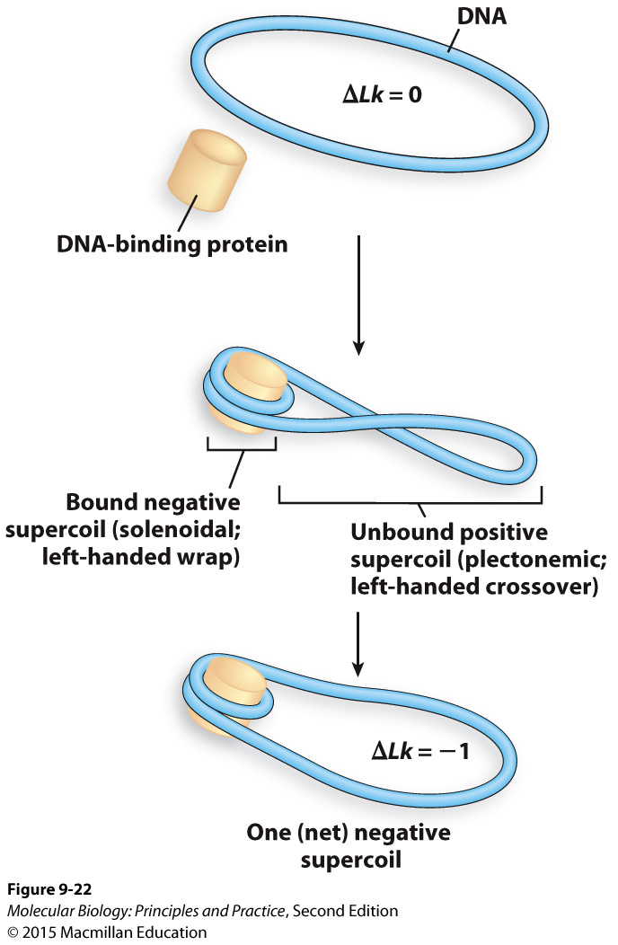
Eukaryotes produce a net negatively supercoiled state by two sequential activities
Wrap DNA around histones to create two opposite types of local supercoiling
Use a topoisomerase to relax the positive local supercoils in the unbound part of the DNA, leading to a NET negatively supercoiled state for the molecule as a whole.

Slide 39
Making and breaking phosphodiester bonds
In general: phosphodiester bonds are made and broken by nucleophilic attacks on phosphates.

Slide 40
DNA replication
Plasmids and circular prokaryotic chromosomes are replicated from a single origin of replication.
Linear eukaryotic chromosomes are replicated from multiple origins of replication.
When an origin fires, it produces two replication forks and move in opposite directions.

Slide 41
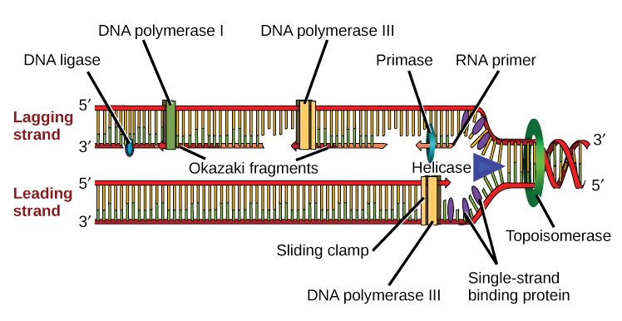
The bacterial DNA replication fork
Beta
Not shown here: Clamp loader
Know the function of each protein, be prepared to identify them on an unlabeled figure, be prepared to draw a replication fork and supply the proteins needed.
Image: Khan Academy

Slide 42
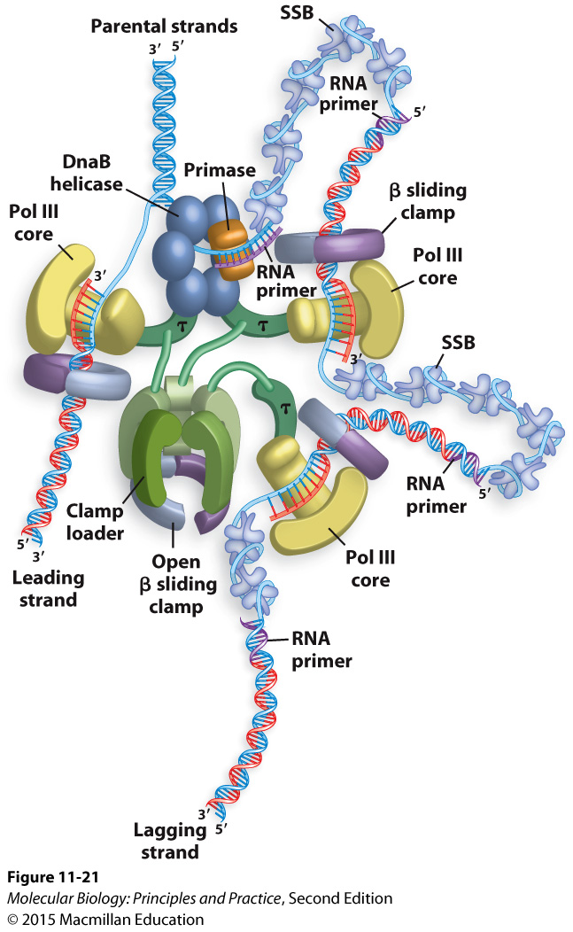
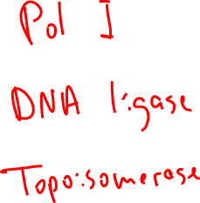
Another view of the bacterial DNA replication fork
(You do not need to be able to draw one that looks like this :)
What other proteins are required to complete replication?
Notes:
(topoisomerase, Pol I, ligase)

